Slide 1
Unit 1: Microbial Growth and Effect of Environment on Microbial Growth Batch Culture
Sweta SushmitaTigga
Lecture- B.Sc Microbiology, Semester-III
Department of Microbiology
DSPMU, Ranchi

Slide 2
Batch Culture
Batch culture- Population growth is often studied by analyzing the growth of microbes in liquid (broth) culture. When microorganisms are cultivated in broth, they usually are grown in a Batch culture; that is, they are incubated in a closed culture vessel with a single batch of medium.
Because no fresh medium is provided during incubation, nutrient concentrations decline and concentrations of wastes increase.
Population growth of microbes reproducing by binary fission in a Batch culture can be plotted as the logarithm of the number of viable cells versus the incubation time. The resulting curve has four distinct phases (figure 7.27), which we examine in this section.

Slide 3
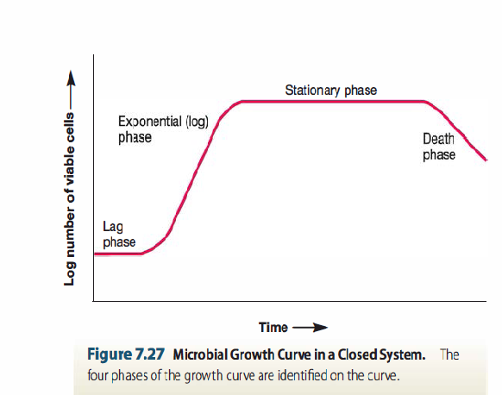
Batch Culture The Growth Curve

Slide 4
Lag Phase
When microorganisms are introduced into fresh culture medium, usually no immediate increase in cell number occurs. This period is called the lag phase.
It is not a time of inactivity; rather cells are synthesizing new components. This can be necessary for a variety of reasons.

Slide 5
Lag Phase
Reasons-
1. The cells may be old and depleted of ATP, essential cofactors, and ribosomes.These must be synthesized before growth can begin
2. The medium may be different from the one the microorganism was growing in previously. In this case, new enzymes are needed to use different nutrients.
Possibly the microorganisms have been injured and require time to recover. Eventually however, the cells begin to replicatetheir DNA, increase in mass, and divide. As a result, the number of cells in the population begins to increase.

Slide 6
Exponential Phase or Log Phase
During the exponential (log) phase, microorganisms are growing and dividing at the maximal rate possible given their genetic potential, the nature of the medium, and the environmental conditions.
Microbes rate of growth is constant during the exponential phase; that is, they are completing the cell cycle and doubling in number at regular intervals.
The population is most uniform in terms of chemical and physiological properties during this phase therefore exponential phase cultures are usually used in biochemical and physiological studies.

Slide 7
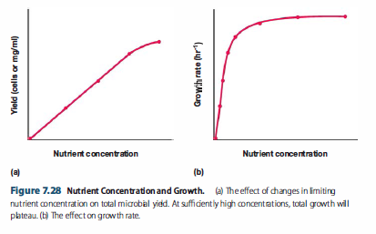
Exponential Phase or Log Phase
The shape of the curve is thought to reflect the rate of nutrient uptake by microbial transport proteins.
At sufficiently high nutrient levels, the transport systems are saturated, and the growth rate does not rise further with increasing nutrient concentration

Slide 8
Exponential Phase or Log Phase
The growth rate during log phase depends on several factors, including nutrient availability.
When microbial growth is limited by the low concentration of a required nutrient, the final net growth or yield of cells increases with the initial amount of the limiting nutrient present (figure 7.28a).
The rate of growth also increases with nutrient concentration (figure 7.28b) but in a hyperbolic manner much like that seen with many enzymes

Slide 9
Stationary Phase
In a closed system such as a batch culture, population growth eventually ceases and the growth curve becomes horizontal.
Final population size depends on nutrient availability and other factors, as well as the type of microorganism.
In stationary phase, the total number of viable microorganisms remains constant. This may result from a balance between cell division and cell death, or the population may simply cease to divide but remain metabolically active.

Slide 10
Why microorganisms enter stationary phase
One obvious reason –
nutrient limitation; if an essential nutrient is severely depleted, population growth will slow and eventually stop.
Aerobic organisms often are limited by oxygen availability. Oxygen is not very soluble and may be depleted so quickly that only the surface of a culture will have an oxygen concentration adequate for growth.
Population growth also may cease due to the accumulation of toxic waste products. This seems to limit the growth of many cultures growing in the absence of oxygen

Slide 11
Senescence and Death Phage
Cells growing in batch culture cannot remain in stationary phase indefinitely. Eventually they enter a phase that for many years was described simply as the "death phase“
Detrimental environmental changes such as nutrient deprivation and the buildup of toxic wastes caused irreparable harm to the cells. That is, even when bacterial cells were transferred to fresh medium, no cellular growth was observed.

